Slide 1
Capstone Project - 3
Team 5: Facebook comment volume prediction
Team Members
Soumyajit
Sweety
Dilavar
Akshay

Slide 2

Content
Problem statement
EDA/Feature analysis
Data Preprocessing
Machine Learning Models
Challenges
Conclusion

Slide 3
Problem Statement
Prediction of comment volume traffic or simply to predict the number of comments a Facebook post would get within a certain number of hours after posting.
Target variable was of continuous nature so it was a regression problem.
We implemented linear and non-linear models such as Multiple Linear Regression, Regularized Regression, PCA, Random Forest and XGBoost to solve the problem.

Slide 4
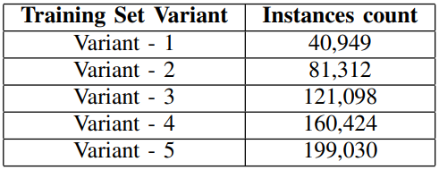
Data Summary
Train dataset
We had 5 variants of train
dataset with different
number of observations.
Test dataset
We had 10 different test dataset with 100 observations each
Features
We had 53 predictor variables and 1 target variable (continuous)

Slide 5
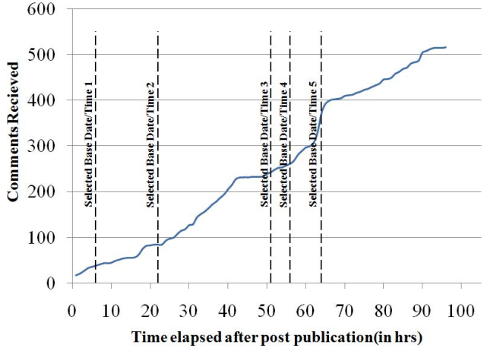
Train Dataset Analysis
Total 5 variants. Variant is defined
as, how many instances of final
training set is derived from single
post of training set. This is done by
selecting different base date/time
for same post at random, process
them individually.
No missing value was present

Slide 6
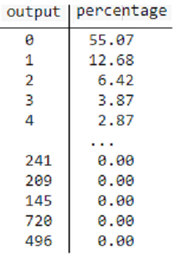
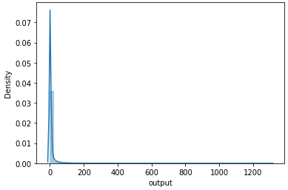
Feature Analysis (Target)
55% posts with
nil comments
High number
of posts with
very few
comments

Slide 7
Feature Analysis (Predictors)
Page Features - Page likes, Page type, Check-in Places, Page Returns
Comments Features w.r.t Time Intervals - CC1, CC2, CC3, CC4, CC5
Derived Features - Min, Max, Avg, Med and Sd of CC features.
Date/Time Features - 7 post published day and 7 base date/time day
Other basic Features - Len of Post, Base Time, Total Hours (for which comments received), Post Share Count.

Slide 8
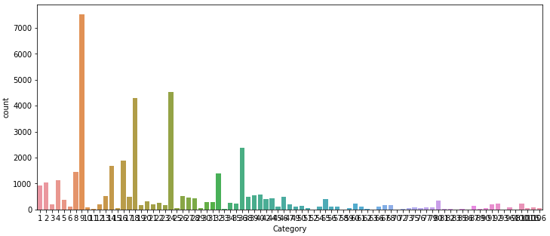
Feature Analysis (Predictors - Categorical)
Page Type
Too many
labels with
unknown
mapping
Unable to
aggregate
labels of
same category like business, entertainment, political
Removed the variable

Slide 9
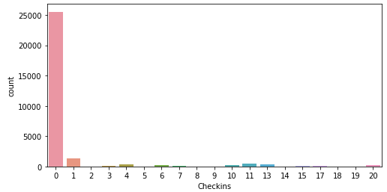
Feature Analysis (Predictors - Categorical)
Check-ins
Too many labels with
unknown label encoding
2. 62% with 0 label
3. Removed the variable (showing check-ins of 20 l

Slide 10
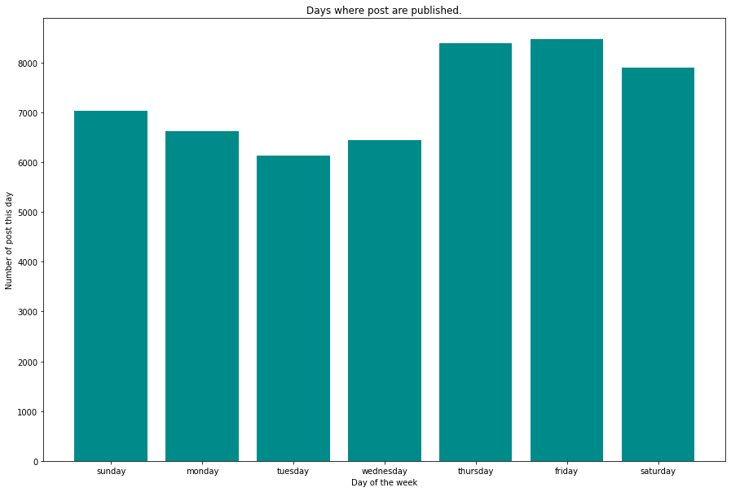
Feature Analysis (Predictors - Categorical)
Day when post published

Slide 11
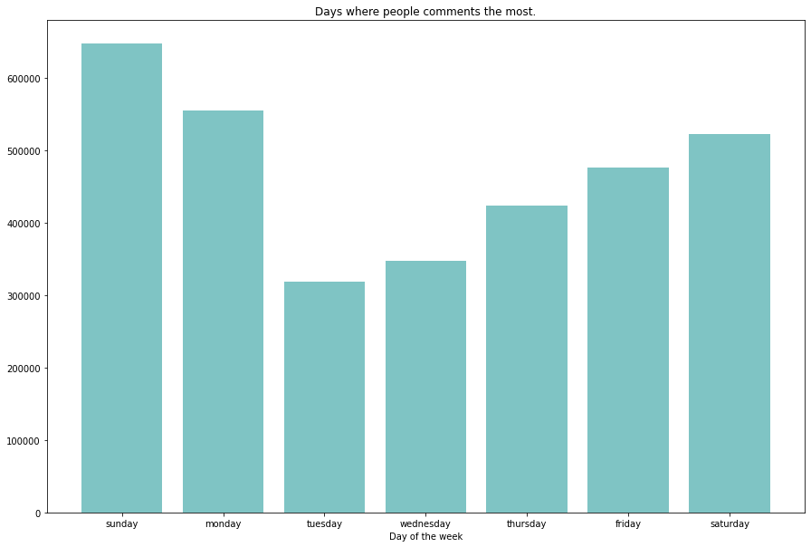
Feature Analysis (Predictors - Categorical)
Day when people actively commenting

Slide 12
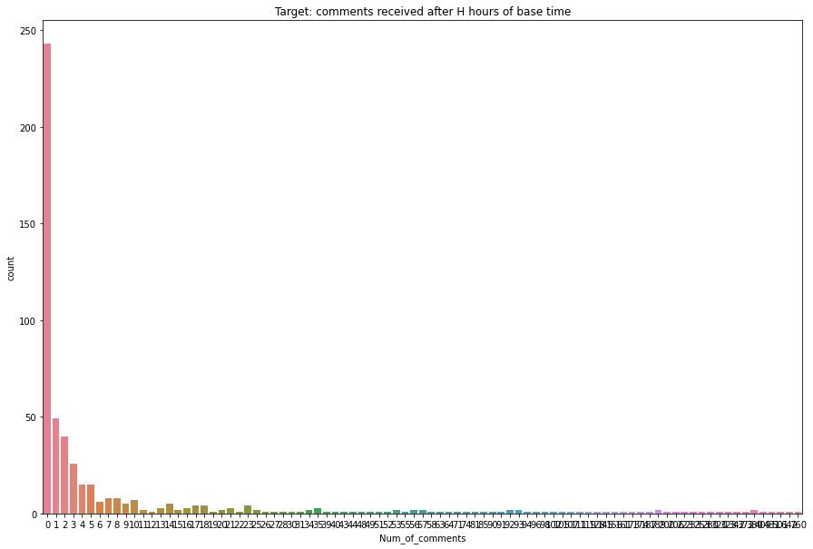
Feature Analysis (Predictors - Continuous)
Comments Received after H hours

Slide 13
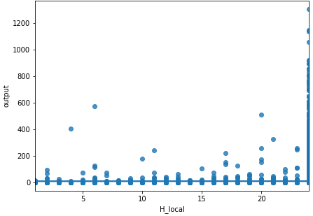
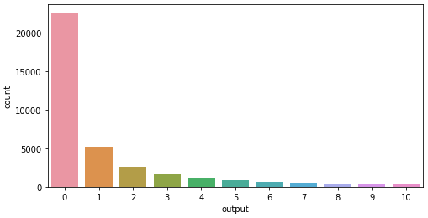
Feature Analysis (Predictors - Continuous)
H_local - Hours, for which we have the comments (target) received
For 98% of post the time was taken for 24 hrs
For hours less than 24, most of the posts got less than 10 comments

Slide 14
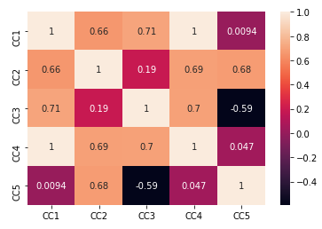
Feature Analysis (Predictors - Continuous)
CC1, CC2, CC3, CC4, CC5 and Derived Features
CC5 was defined as CC2-CC3. So,
among CC2, CC3 and CC5 we can
remove one column to reduce
the redundancy
CC1 & CC4 has strong correlation (1)
Derived features also have high
correlation
We have applied multi-collinearity removal methods to solve the issue

Slide 15
Pre-processing (Final Steps)
Removed cat variables Page type, Check-ins, Post promotion status
Changed date/time features to categorical and created two columns as weekdays and weekends.
Removed redundant column CC3 and its corresponding derived features after checking with Random Forest Feature Importance
Scaled the data using standardscaler method
Applied regularization techniques to tackle multicollinearity

Slide 16
Machine Learning Models
We have Implemented Below Models
Multiple Linear Regression
Lasso Regression
Ridge Regression
Decision Tree Regression
Random Forest Regression
XGBoost Regression
Gradient Boosting Regression
KNN Regression
Compared Train and Test accuracy for all models

Slide 17
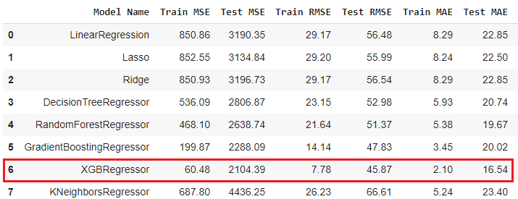
Model Evaluation (MSE, RMSE, MAE)

Slide 18
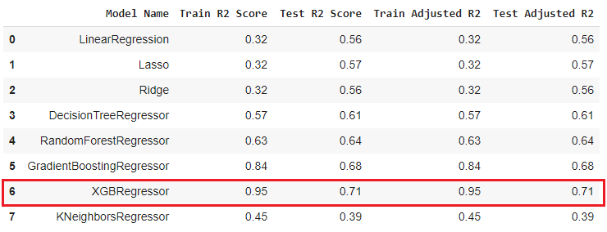
Model Evaluation (R2 and Adjusted R2)

Slide 19
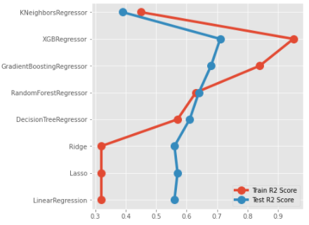
Model Evaluation ( Comparison of R2 Score)

Slide 20
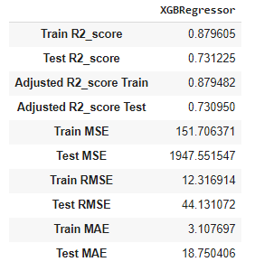
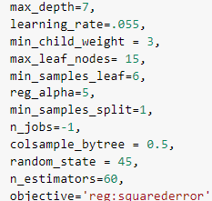
Model Evaluation (XGBoost)
Evaluation metrics
Best hyperparameter
XGBoost

Slide 21
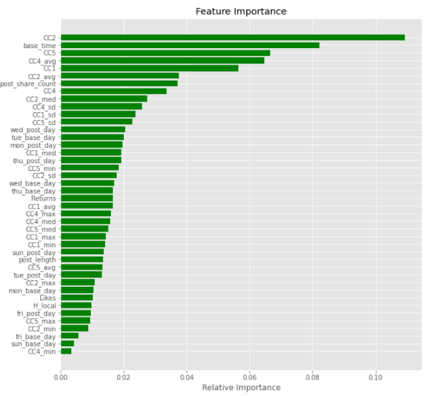
Model Evaluation (Feature Importance)
XGBoost

Slide 22
Challenges
5 variants of datasets
Large train dataset
Very small test dataset
High number of features
Skewed target - 55% had 0 comments (unable to use log transform)
Categorical variables with high number of labels (106 labels)
Unknown label encoding so was not able to map labels with code
High multicollinearity because of 25 derived variables

Slide 23
Conclusion
XGBoost performed best on our dataset with test adjusted R2 score of 0.73
Gradient Boosting and Random Forest also performed well compared other models
From feature importance plot of Random Forest, Gradient Boosting and XGBoosting we can conclude that most important features are
CC2 (Comment count in last 24 hrs w.r.t to selected basetime)
Base Time/Date
Dataset was large, so unable to use grid-search to find the optimal hyperparameters. Model accuracy can be improved.

Slide 24
Q & A

